Slide 1
IBM Machine Learning
Wholesale customers Analysis
Yu Hsuan HSIEH
April 2023

Slide 2
Summary & Objective
This is a project analyzing wholesale customer purchases.
The dataset used in this project is provided by Kaggle.
We’ll first observe the dataset, cleaning will be performed if needed, then fit the dataset into 3 different models, K-means, DBSCAN and Agglomerative Clustering.
Models will be evaluated and compared to find out the best model that fits the data.
The main goal of this analysis will be trying to train a model that best clusters the column “Fresh” and “Milk” in the dataset.
The objective of this project is to find clusters for customers that purchase both Fresh and Milk products.

Slide 3
Data Observation

Slide 4
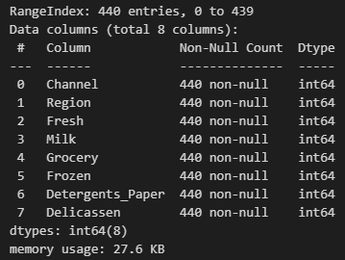
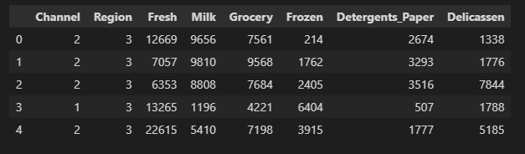
Dataset
From the result of data.head() and data.info(), we can see that there’re 8 columns in the dataset. Each column is integer, thus we don’t have to convert the datatype.

Slide 5
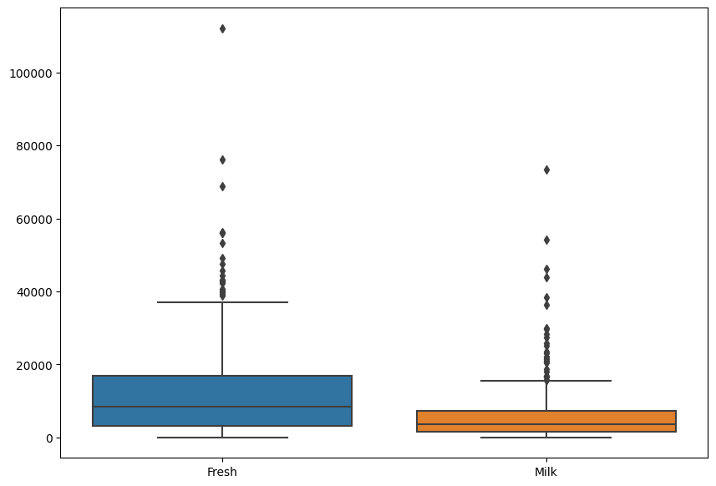
Dataset
However, observing the Fresh and Milk columns, we can see that there are some outliers. We will perform data cleaning then.

Slide 6
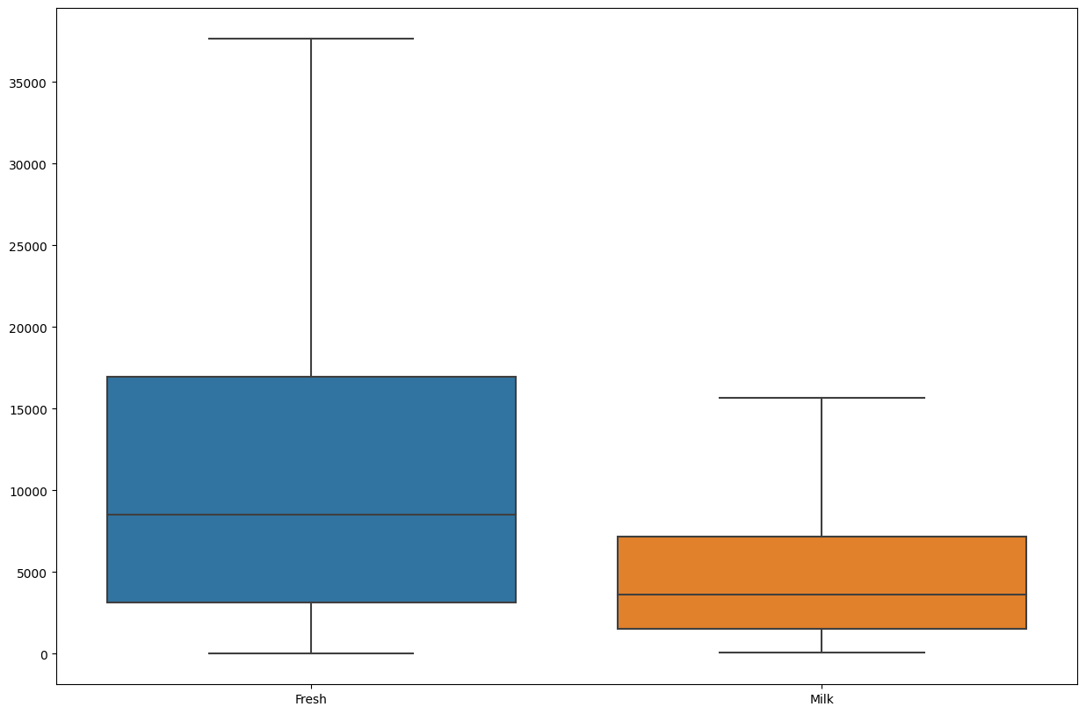
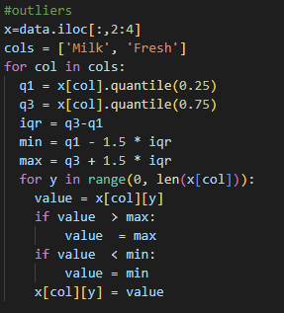
Outlier
After performing below codes, we can plot the graph again, observing that the outliers are deleted.

Slide 7
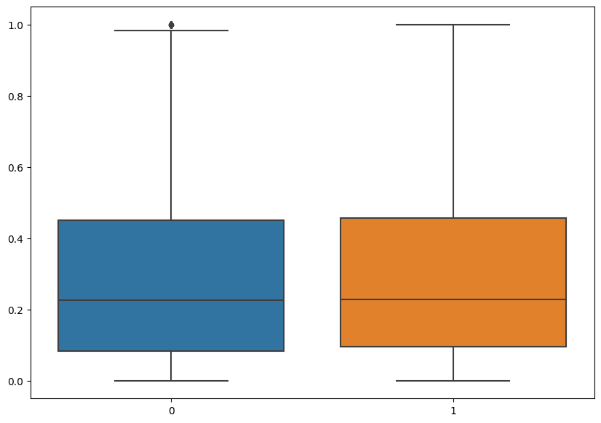
Scaling
Next, we’ll perform data scaling. Scaling is essential for clustering.
The scaler we’re using will be MinMaxScalar().
Observe the graph right, we can see that the scales have converted to 0 - 1.

Slide 8
Model I: K-Means

Slide 9
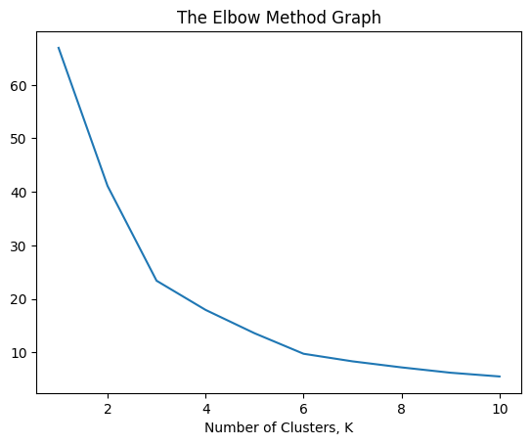
K-Means - Elbow Graph
For the first step, we’ll obtain the elbow graph for cleaned data in order to get the optimal # clusters.
From the graph right, we can see that the optimal number of clusters is 6.
Therefore we’ll be using 6 as the parameter for clusters in the following models.

Slide 10

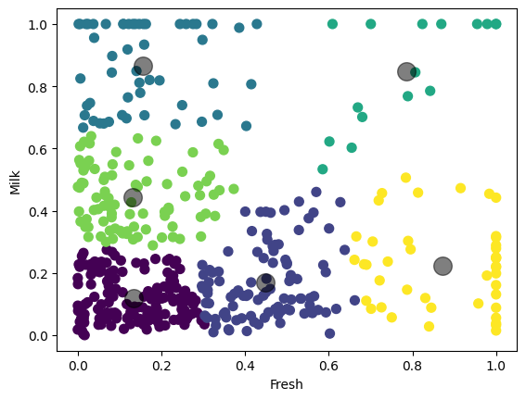
K-Means
We then start initializing and fitting our data.
Plotting the result.

Slide 11
DBSCAN

Slide 12

DBSCAN
DBSCAN doesn’t require users to set the number of clusters, however, users must input 2 parameters - eps and min_samples.
For tuning the parameters, our primary goal is to eliminate the number of noise, since outliers are deleted in previous steps.

Slide 13
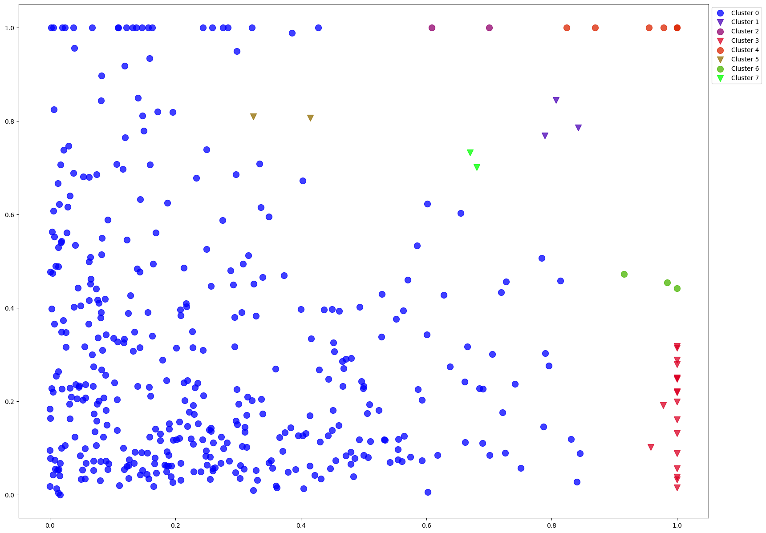
DBSCAN
The scatter graph of DBSCAN is shown right.

Slide 14
Agglomerative Clustering

Slide 15
Agglomerative Cluster
For Agglomerative clustering, we will use the optimal # clusters that we obtained in previous steps - 6.

Slide 16
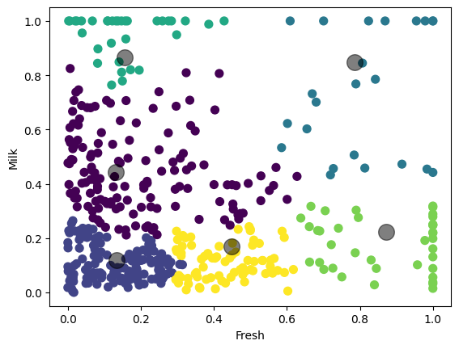
Agglomerative Cluster
The scatter graph of Agglomerative Cluster is shown below.

Slide 17
Conclusion

Slide 18
Evaluation
Since there is no fixed method for evaluating unsupervised learning, therefore we will be evaluating the 3 models based on their scatter plots.
K-Means | DBSCAN | Agglomerative Cluster

Slide 19
Evaluation
We can see that DBSCAN with the parameters mentioned has the poorest result, K-Means has a slightly better result compared to Agglomerative clustering.
K-Means | DBSCAN | Agglomerative Cluster

Slide 20
Possible Flaw
K-means is sensitive to the initial placement of cluster centers. Different initializations can lead to different solutions, and there is no guarantee that the algorithm will find the global optimum.
DBSCAN can be sensitive to the choice of the distance metric and the value of the eps and min_samples parameters. Different parameter settings can lead to different clustering results.
Agglomerative clustering is sensitive to the choice of the linkage criterion, which determines how clusters are merged. Different linkage criteria can lead to different clustering results.

Slide 21
Suggestion
For further research, we can try tuning the parameters for different clustering methods, try to find the optimal parameters. Moreover, we can try evaluating the methods with more ways, to get a more comprehensive analysis.

Slide 22
Conclusion
Our study demonstrates the effectiveness of K-means, DBSCAN and Agglomerative Clustering methods for analyzing the dataset. We recommend using the K-Means method, but the other models also have their advantages and may be suitable for specific use cases.
Overall, our findings provide useful insights for anyone interested in using unsupervised machine learning methods for the wholesale customers dataset, and highlight the potential for further research in this area.

Slide 23
Thank you!

